Slide 1
Driver To Drive
By: Paul Swisher, Nathan Mclauglhin
Notes:
Example of the data structure

Slide 2
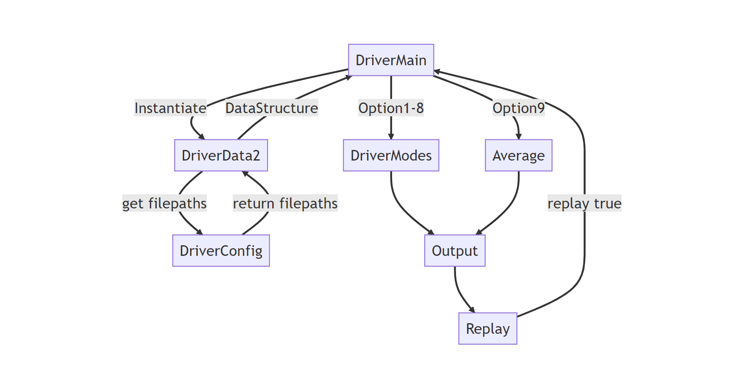
Software Design Diagram
Notes:
What:
Why:
This program reads two csv files of driver specific information curated manually and assigns them into memory with single data structure of a dictionary of dictionaries or map of hashmaps. Then, several modes are offered to the user to choose the next operations 1-9 with 10 being an exit.

Slide 3
Driver Data Analysis:
print_keys: Displays sorted and unsorted keys.
pretty_print: Formats and prints nested data.
search_by_key_and_value: Searches data by key and value.
sample_calculation: Demonstrates mileage cost calculation.
total_miles: Calculates total miles and costs.
calculate_distances: Selects and calculates distances for specified drivers.
total_time: Sums total time from data.
search_by_value: Recursive search for values.
Notes:
print_keys (driver): This method prints all keys in the nested dictionary. It uses sorted to order the keys alphabetically, which has a time complexity of O(n log n). This method is useful for getting an overview of the data.
pretty_print (data): Utilizes the pprint module to format and print the nested dictionary in a readable manner. The time complexity is O(n), which is efficient for visualizing complex nested structures.
search_by_key_and_value (driver_data, driver): Allows the user to select a key from a numbered list and then enter a value to search for within that key. The method's time complexity is O(n), primarily due to the list creation and key iteration.
sample_calculation (driver_data, driver): Demonstrates a specific calculation (miles multiplied by a cost per mile). It has a constant time complexity O(1), indicating its efficiency and independence from the size of the data.
total_miles (driver_data, driver): Computes the total miles driven and the associated cost. It iterates over all the keys in the data, resulting in a time complexity of O(n).
calculate_distances (cls): Allows users to select a range of data for distance calculation based on driver IDs. The time complexity is O(k), where k is the size of the selected range. This method is more selective and potentially more efficient than processing the entire dataset.
total_time (driver_data, driver): Sums up all the time values in the data, with a time complexity of O(n). It is straightforward and efficient for calculating total time from the dataset.
search_by_value (driver): Implements a recursive search for a specified value within the nested dictionary. The time complexity is O(n), as it potentially explores every element in the structure.

Slide 4
DriverMain Menu Features
1 - View Available Keys: Displays keys from the data. Complexity: O(n log n).
2 - View All Data: Shows data in a readable format. Complexity: O(n).
3 - Sample Calculation: Demonstrates a sample calculation. Complexity: O(1).
4 - Single Data Viewing by Key: View data for a specific key. Complexity: O(n).
5 - Search Data for a Value: Search the data for a specific value. Complexity: O(n).
6 - View Total Miles and Cost: Displays total miles and cost for all drivers. Complexity: O(n).
7 - View Total Combined Time: Shows total time driven. Complexity: O(n).
8 - View Range of Data: Displays a range of sorted example miles data. Complexity: O(k).
9 - Run the Numbers: Executes calculations using the Average module. Complexity: O(n).
10 - Quit: Exit the program.
Notes:
"Interactive menu for analyzing and managing the driver data using DriverModes and DriverData2 modules."

Slide 5
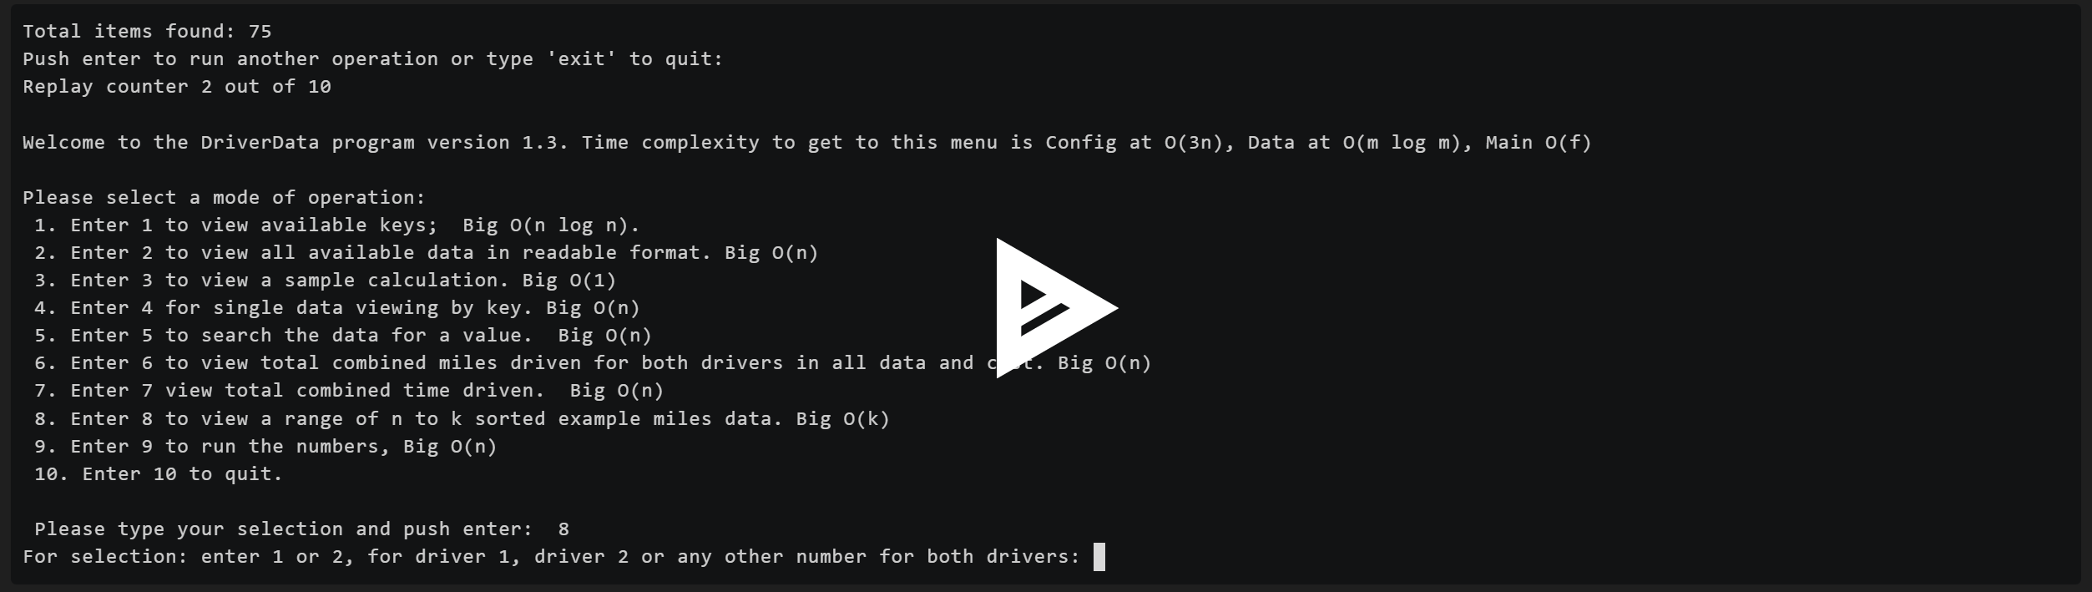
Demo:
Notes:
https://asciinema.org/a/J5m0wUhuOukmelq7S9u3xflig
From Gitpod:
run >>> python /workspace/upper-division-cs/dsa-23au/java-dsa/pswish-natmcl/pswish-app/python/Version1_3/DriverFiles/DriverMain.py
or
run >>> python /workspace/upper-division-cs/dsa-23au/java-dsa/pswish-natmcl/pswish-app/python/Version1_3/DriverFiles/BackupLogic.py

